Slide 1
Compleat
No that isn’t spelled wrong

Slide 2
The Name and it’s Meaning
Compleat is an archaic spelling for the word complete, yet has a bit of a more subtle meaning.
com·​pleat | \ kəm-ˈplēt - having all necessary or desired elements or skills

Slide 3
Big Picture
The application developed within the confines of our classroom was wide and deep, or at least was supposed to be. It would be a tool to help those in similar business lines as mine (as well as our own shop) to more readily conduct business.
It was to include a Dashboard for some quick and dirty statistics. This would tie into an ERP system of our own design to pull quick numbers like Sales numbers.
It was also to include a host of tools for quick tasks like printing barcode labels, adding inventory to the ERP, etc.
It was also to house a task manager to tie into a central tasks repository like Trello or NextCloud.

Slide 4
What we Ended up with….
The only functionality currently enabled is a terrible implementation of the dashboard features.
And, a inventory builder application that can scan a barcode and query an API to pull data.

Slide 5
What Happened?

Slide 6
Part 1 Rabbit Holes

Slide 7
Rabbit Holes
One of the big issues I struggled with as a team of one was keeping track of what I was doing from session to session.
Since the size of the project was vast and touched many different pieces there were a lot of things in the app development world that took up my time.
Here are just a few

Slide 8
Rabbit Holes – Part 1
Fragments – These are nice little additions to an application that keeps you from cluttering the app with activities. Once an activity loads all of its Fragments load automatically. This also complicates making simple things like RecyclerAdapters and things work.
Layouts – Holy mother of all that is holy…. Why is app layouts harder than HTML!?! Why can I not specify for a particular object to take up half of the screen?!?
Outdated APIs – Why is every other person and their brothers out there writing about super old deprecated APIs, and why is the official documentation not updated! You know how hard it is to make the camera work!?!
Standard Widgets – Why is there no standard components and layouts available? I get that every app doesn’t need to look the same,but lots of people want a camera and a camera can look the same throughout most apps and everyone is better off because of it!

Slide 9
Rabbit Holes – Part 2
OAuth – This is one I can kind of understand, but…. It’s pretty ubiquitous…. You would think there would be some easy ways to implement this out there. But guess what, there isn’t. One implementation that I found that didn’t touch the actual accounts on the phone itself was well over 800 lines and wasn’t documented. I spent at least 10 hours and gave up on this one.
Kotlin – Actually this one was pretty nice to work with. I wish that more stuff was written in Kotlin as far as examples and such goes, but for the most part JetBrains is able to translate it pretty well.
Conflicting Libraries – I ran into this more than I would like to admit. There are libraries that include same or similar functions with wildly different applications of that function. I spent way too much time trying to figure out why my function I basically copy/pasted from another individuals working code wouldn’t work!
Asynchronous Communication – Great when it works, a beast when you don’t have time to deep dive into the Olympic Size swimming pool the Android codebase is…..

Slide 10
Part 2 Extracurricular Activities

Slide 11
Extracurricular Activities
The second issue that I had was outside the app development itself.
Since my project was to touch a lot of facets of a business, it required interfacing with a lot of things, that aren’t readily visible inside the application itself.
Especially since a lot of the items I worked on didn’t end up making it into the final product. (Yet….)

Slide 12
Extracurricular Activities – Label Printing
One of the first things I tackled was getting the ability to print to an outside printer. Which isn’t all that hard if you are printing to a standard printer that is connected via wifi to a network. It becomes infinitely harder to print to most label printers. This is because most label printers are setup to be always connected to a device via Parallel or USB connection.
This was trouble as I would need a print server to act as a repository for images that it would then scrape and print.
This was accomplished via a RPI setup with CUPS. The issue is finding drivers that work with CUPS is sometimes a nightmare. I ended up having to compile from source some drivers that I ended up making work with my device.
I now have an RPI with CUPS, polling a folder on the device that will then print the barcodes depending on size to different printers!

Slide 13
Extracurricular Activities – ERP System
Since we’ve started our business one of the keystone items I’ve wanted to implement into them is an ERP. (Enterprise Resource Planning) These systems roll lots of great features into a single platform.
The one in particular I have been eyeing is OpenERP. It has manufacturing, accounting, shipping/receiving, ecommerce, CRM, and loads of other stuff built in.
It is a system that is written in python and is open source so it would be a great target for this project and future projects as well.
After spending several weeks going through and trying to study the inner workings of the system I decided that I should cut my losses and jump ship as time was waning and it would only be a small addition to my project.

Slide 14
Extracurricular Activities – Card Scanning
One of our business functions is the sell of “Singles”. These individual cards that are split up inventoried, graded, priced, sorted, and stored.
There are several applications out there that make it easy to look up singles via scanning them via a camera. I thought that this would be a great project and since I was already using FireBase’s MLKit for Barcode Scanning it shouldn’t too hard to train an accurate model.
Boy was I wrong, looking back I think I would approach the situation much differently. I was training a model on the entirety of a card which wasn’t really allowing me to do much with the globs of text on the card. Oh btw the cards have names that are unique identifiers for the most part….

Slide 15
Part 3 Life

Slide 16
Life
I don’t think it’s really fair to blame the incompletion of my vision on life in general or even COVID-19, but it didn’t help.
The virus in general has meant that we have had to change everything about the way we do business including the way we earn a living.
In doing so it put immense pressure on us with kids and the business that mostly wouldn’t allow us to focus on things outside of those areas.
Again…. Not an excuse, but it is a contributing reason.
Oh and I’m a perfectionist…. Jeez I spent way too many hours looking at trying to make the UI better instead of creating a MVP.

Slide 17
What went right?

Slide 18
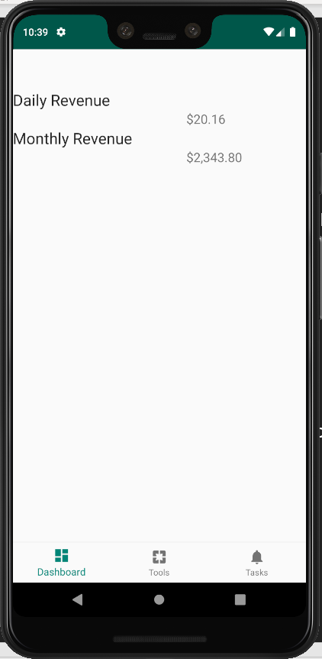
Dashboard

Slide 19
Dashboard
So the dashboard isn’t perfect.
It isn’t linked up to the ERP like I would like it and the API Access Codes aren’t secured through OAuth
It isn’t pretty and it doesn’t have graphs to help visualize the data.
But, it works somewhat. Currently I have it able to pull data from the day (hardcoded) and month (also hardcoded) of sales.
This isn’t great…. But hey its querying and handling the Square API and adding additional items to this as well as sprucing the design up isn’t much more work, just time consuming.

Slide 20
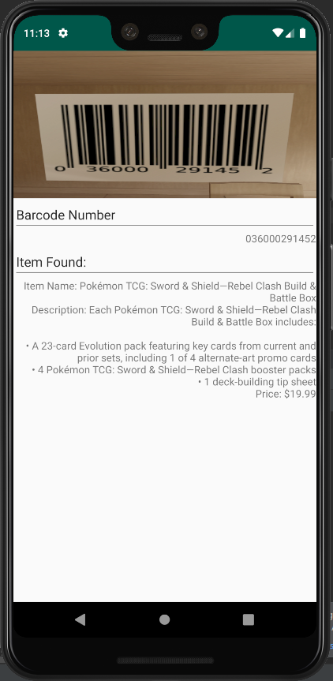
Inventory Builder

Slide 21
Inventory Builder
There is no “builder” in the Inventory Builder!
The cake is a lie!
So, right now it links up to our square inventory and works. Scan a barcode that exists walah information about that item.
Doesn’t allow the adding of items currently, which would require only slightly more time now that all of this is working.

Slide 22
The End of the Day (Semester)

Slide 23
The End of the Day
I wish I hadn’t ran though as many holes as I did or at the very least given up when the bottom was nowhere to be found!
Some of the side projects for this application ended up getting done, but never implemented into the app so crucial time was spent doing things that had no direct impact on the output at the end of the day.
I learned a ton and will probably keep tinkering with this and may turn it into a fully fledged product in the future.
I believe I want to make Compleat into a suite of tools for businesses like mine.

Slide 24
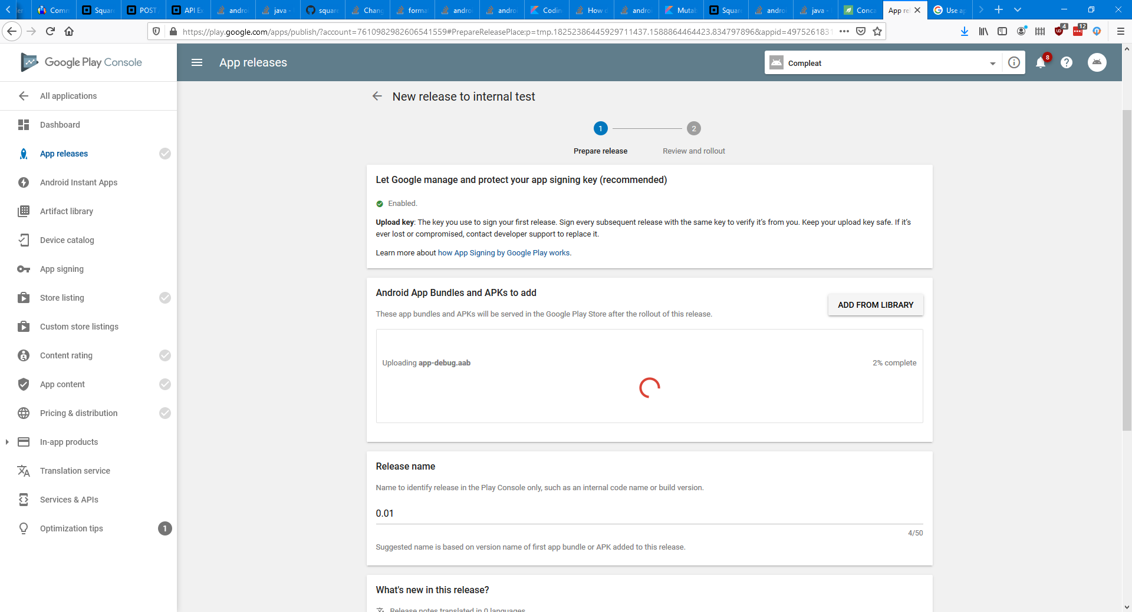
Proof of App Store Submission
My internet right now is crap…. This is only 26MB, but over 1 bar cell signal…. OH FUN!

